Slide 1

UI WEB DEVELOPMENT
(MR23-1CS0102)
UNIT-II
Cascading Style Sheets
UI Web Development
Unit 2
Department of CSE
Notes:
You can safely remove this slide. This slide design was provided by SlideModel.com – You can download more templates, shapes and elements for PowerPoint from http://slidemodel.com

Slide 2
Syllabus
UNIT – II
UNIT– II: Cascading Style Sheets Introduction, CSS Selectors, Element Selector, ID selector, class selector, universal selector, CSS Colors, Background, Border, Attribute Selectors, CSS Text and Fonts, Gradient and shadows
https://developer.mozilla.org/en-US/docs/Learn/CSS
https://developer.mozilla.org/en-US/docs/Learn/CSS/First_steps

Slide 3
Introduction

Slide 4

History of CSS
A journey CSS was first proposed by Hakon Wium Lie on October 10, 1994.
CSS was proposed in 1994 as a web styling language
Hakon wium lie is know as father of CSS.
CSS is a style sheet language
UI Web Development
Unit 2
Department of CSE

Slide 5
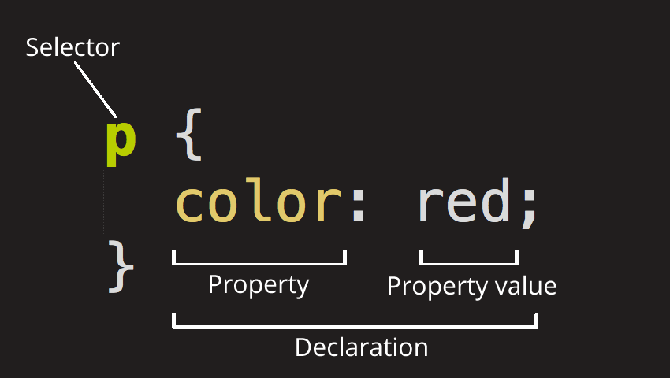
Introduction to CSS
CSS stands for Cascading Style Sheets. Styles define how to display the HTML.
Cascading Style Sheets (CSS) is a rule based language that applies styling to HTML elements. We write CSS rules in Html elements (<p>, <img>), and modify properties of those elements such as color, background color, width, border thickness, font size, etc.
CSS ruleset, is made up of:
Selector
Declaration
Properties
Property value
UI Web Development
Unit 2
Department of CSE

Slide 6
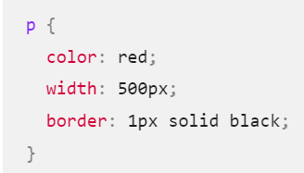
CSS ruleset, is made up of:
Selector
Declaration
Properties
Property value
each ruleset must be wrapped in curly braces. ({})
use a colon (:) to separate the property from its value or values.
use a semicolon (;) to separate each declaration from the next one.
UI Web Development
Unit 2
Department of CSE

Slide 7
CSS Selectors, Properties and Values
https://developer.mozilla.org/en-US/docs/Web/CSS/Reference

Slide 8
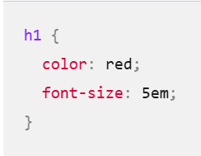
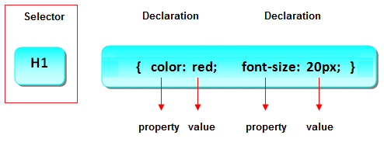
Selector
Identifies the HTML elements that the rule will be applied to, identified by the actual element name, e.g. <body>, <p>, <h1>
em: Relative length units: size of text or other elements scales relative to everything else on the page
px: absolute length units. considered to always be the same size.

Slide 9
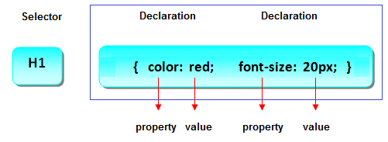
Example of Selector
h1
{
color:red;
font-size:10px;
}
Declaration Block
Declaration Block is multiple declaration lines including the curly braces
UI Web Development
Unit 2
Department of CSE

Slide 10
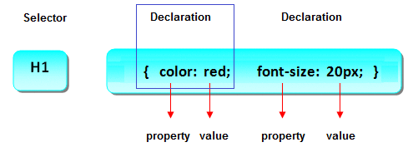
Declaration
Declaration part contains property and value. Example: suppose that we want size of our text 10px then it declare as font-size:10px. Here font-size is properties and 10px is there value, and all this declaration is called declaration.
UI Web Development
Unit 2
Department of CSE

Slide 11
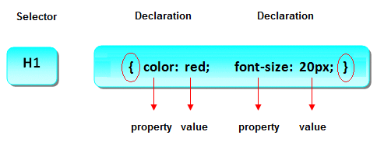
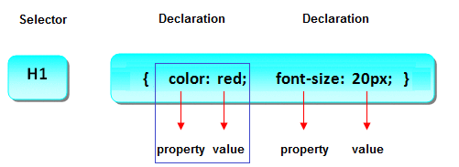
Curly Braces
Property & value
The properties is the style attribute you want to change and values is value of attribute. Example: suppose that we want to change size of our text 10px and color is red then it declare as font-size:10px; color:red. Here font-size is properties and 10px is there value and color is also properties and red is there value
UI Web Development
Unit 2
Department of CSE

Slide 12
Types of CSS
Styling can be added to HTML elements in 3 ways:
Inline - using a style attribute in HTML elements
Internal - using a <style> element in the HTML <head> section
External - using one or more external CSS files
The most common way to add styling, is to keep the styles in separate CSS files.
Inline Styling (Inline CSS)
Inline styling is used to apply a unique style to a single HTML element: Inline styling uses the style attribute.
This example changes the text color of the <h1> element to blue
Example
<h1 style="color:blue;">This is a Blue Heading</h1>
UI Web Development
Unit 2
Department of CSE

Slide 13
Internal Styling (Internal CSS)
Internal styling is used to define a style for one HTML page.
Internal styling is defined in the <head> section of an HTML page,
within a <style> element
Example
<style>
body {background-color:lightgrey;}
h1 {color:blue;}
p {color:green;}
</style>
UI Web Development
Unit 2
Department of CSE

Slide 14
External Styling (External CSS)
An external style sheet is used to define the style for many pages.
With an external style sheet, you can change the look of an entire web site by changing one file!
To use an external style sheet, add a link to it in the <head> section of the HTML page
UI Web Development
Unit 2
Department of CSE

Slide 15
Here is how the "styles.css" looks:
body {
background-color: lightgrey;
}
h1 {
color: blue;
}
p {
color:green;
}
<head>
<link rel="stylesheet" href="styles.css">
</head>
UI Web Development
Unit 2
Department of CSE

Slide 16
Element Selector, ID selector, class selector, universal selector

Slide 17
CSS Selector
Selector are used for select an Html element it is select by name, id, class etc.
id selector
class selector
Element Selector
Group Selector
Universal Selector
Attribute selector
Pseudo-class selector
UI Web Development
Unit 2
Department of CSE

Slide 18
Element Selector
It is used to select an Html elements by name.
A Element selector is sometimes referred to as a tag name selector or type selector because it selects an HTML tag/element in your document.
Type selectors are not case-sensitive.
Example
<style>
h1{
color: red;
font-size: 18px;
}
p{
color: red;
font-size: 18px;
}
</style>
UI Web Development
Unit 2
Department of CSE

Slide 19
id Selector
The id selector is used to specify a style for a single, unique element.
The id selector uses the id attribute of the Html element, and
is defined with a "#".
Example
<p id="aaa"> This is styled using id selector:aaa</p>
#aaa{
/*id selector*/
padding:15px;
color: rgb(9, 231, 175);
border: 5px solid rgb(231, 9, 9);
text-align: justify; }
UI Web Development
Unit 2
Department of CSE

Slide 20
class Selector
The class selector is used to specify a style for a group of elements.
This allows you to set a particular style for many Html elements with the same class.
The class selector uses the Html class attribute, and is defined with a ".“
Example
<h1 class="a12">This is styled using class selector:a12</h1 >
<p class="a12">This is styled using class selector:a12</p>
.a12{
padding: 10px;
color: rgb(189, 7, 209);
border: 5px solid rgb(233, 244, 30);
}
UI Web Development
Unit 2
Department of CSE

Slide 21
Group Selector
By using group selector you can apply same style of number of Html elements. Grouping selector is used to minimize the code. Here commas are used to separate each selector in grouping.
Example
<style>
h1, h2, p{
color: red;
font-size: 18px;
}
</style>
UI Web Development
Unit 2
Department of CSE

Slide 22
Style1.css
span {
background-color: yellow;
}
strong {
color: rgb(246, 16, 16);
}
em {
color: rgb(51, 153, 109);
}
/*class selector*/
.abc {
color: orange;
font-weight: bold;
}
/*id selector*/
#four{
background-color: skyblue;
text-align:center;
}
/*group selector*/
h2,h3{
color: rgb(239, 26, 129);
}

Slide 23
Example2.html
<!doctype html>
<html lang="en">
<head>
<meta charset="utf-8" />
<link rel="stylesheet" href="style1.css" />
<title>Types of selector example </title>
</head>
<body>
<h1>I am a level one heading</h1>
<p>
This is a paragraph of text. In the text is a
<span>span element</span> and also a
<a href="https://example.com">link</a>.
</p>

Slide 24
Example2.html
<h2>This is second heading</h2>
<p>
This is the second paragraph. It contains an <em>emphasized</em> element.
It has a <strong>strong</strong> element
</p>
<h3>This is 3rd heading</h3> <ul>
<li>Item <span>one</span></li>
<li class="abc">Item two</li>
<li>Item <em>three</em></li>
<li id="four"> Item 4</li>
</ul>
</body>
</html>

Slide 25
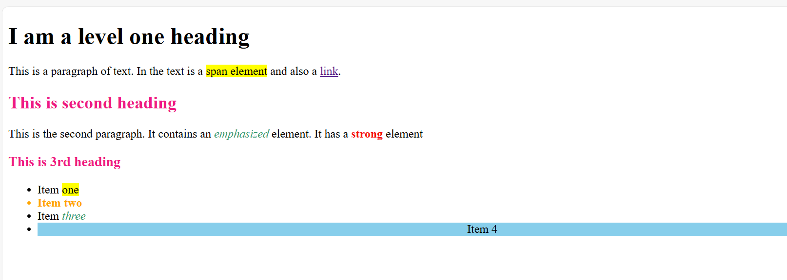
output

Slide 26
Universal Selector
The universal selector is used to selects all the elements on the pages.
Example
<style>
* {
color: red;
font-size: 18px;
}
</style>
UI Web Development
Unit 2
Department of CSE

Slide 27
Example3.html
<!DOCTYPE html>
<html lang="en">
<head>
<meta charset="UTF-8">
<meta name="viewport" content="width=device-width, initial-scale=1.0">
<title>Universal Selector</title>
<style>
* {
color: red;
font-size: 18px;
}
</style>
</head>

Slide 28
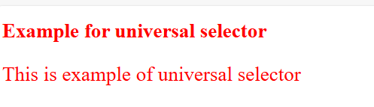
<body>
<h1>Example for universal selector</h1>
<p>This is example of universal selector</p>
</body>
</html>

Slide 29
CSS Attribute Selector
The CSS attribute selector is used when we want to style multiple HTML elements that have the same attribute or attribute values.
It is a very convenient way to style multiple-element by grouping them on a basis of similar attributes.
The attribute selector selects all the elements that have a particular attribute and sets the styling for all of them.
The attribute selectors are by default case sensitive and can be written in the square brackets [].
UI Web Development
Unit 2
Department of CSE

Slide 30
Types of attribute selector
There are several types of attribute selector, which are given below:
CSS [attribute] selector
CSS [attribute="value"] selector
CSS [attribute$="value"]
CSS [attribute] selector
The [attribute] selector selects all the elements that contain the same attribute and applies the CSS properties to all of them at once.
For example, the .selector [class] will selects and style all the elements that have the same class name.
Syntax of [attribute] selector
HTML element[attribute]/[attribute]{
/* CSS properties*/
}
UI Web Development
Unit 2
Department of CSE

Slide 31
Example
<style>
[class] {
background-color: red;
color: black
}
<p class="para">This is the first paragraph.</p>
UI Web Development
Unit 2
Department of CSE

Slide 32

attribute Selector
style HTML elements that have specific attributes
The [attribute] selector is used to select elements with a specified attribute.
<style>
a[target="_blank"] {
background-color: yellow;
} </style>
<body>
<a href="https://www.w3schools.com">w3schools.com</a>
<a href="http://www.disney.com" target="_blank">disney.com</a>
<a href="http://www.wikipedia.org" target="_top">wikipedia.org</a>
</body>

Slide 33
Box Model

Slide 34
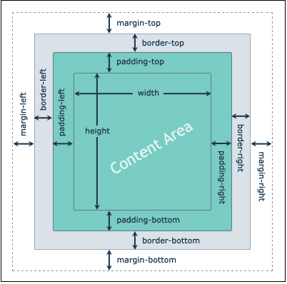
Box Model

Slide 35
Box Model
Everything in CSS has a box around it- a container that contains various properties. These properties collectively determine the dimensions and spacing of an element.
Content - The content of the box, where text and images appear
Padding - Clears an area around the content. The padding is transparent
Border - A border that goes around the padding and content
Margin - Clears an area outside the border. The margin is transparent
width:
height:

Slide 36
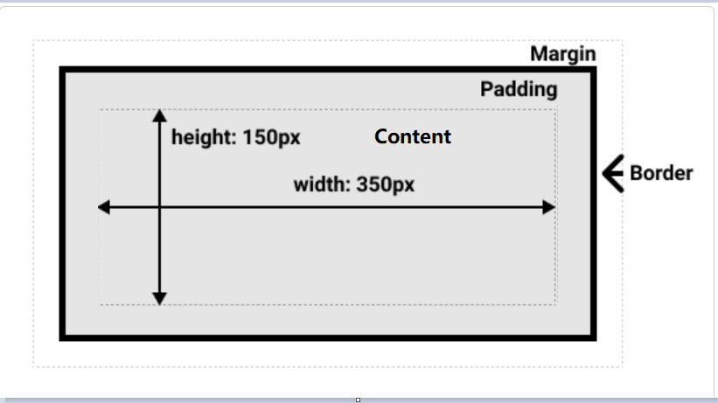
.box {
width: 350px;
height: 150px;
margin: 10px;
padding: 25px;
border: 5px solid black;
}

Slide 37
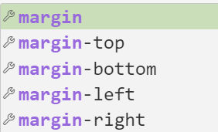
Margin
/* Apply to all four sides */
margin: 1em;
margin: -3px;
/* top and bottom | left and right */
margin: 5% auto;
/* top | left and right | bottom */
margin: 1em auto 2em;
/* top | right | bottom | left */
margin: 2px 1em 0 auto;
auto means automatically adjusted.
-ve margin pulls elements closer together or overlapping them

Slide 38
Margin
When one value is specified, it applies the same margin to all four sides.
Ex: margin: 0;
When two values are specified, the first margin applies to the top and bottom, the second to the left and right. Ex: margin: 20px, 20px;
When three values are specified, the first margin applies to the top, the second to the right and left, the third to the bottom.
margin: 20px, 30px, 20px;
When four values are specified, the margins apply to the top, right, bottom, and left in that order (clockwise).

Slide 39
padding
padding
padding-top
padding-right
padding-bottom
padding-left
/* Apply to all four sides */
padding: 1em;
/* top and bottom | left and right */
padding: 5% 10%;(2 values)
/* top | left and right | bottom */
padding: 1em 2em 2em;(3 values)
/* top | right | bottom | left */
padding: 5px 1em 0 2em; (4 values)
padding: 10px 5% 2em 15px;
Padding cant be -ve

Slide 40
Typography/Fonts

Slide 41
CSS Font
CSS font is used for design text or font for display on web page.
CSS font properties define the font family, boldness, size, and the style of a text.
CSS font is shorthand property of the following:
font-family: 'Franklin Gothic Medium', 'Arial Narrow', Arial, sans-serif
font-size: 2px, larger, 200%, 1.6em
font-style: normal| italic| oblique
font-weight: Thin, Light, Regular, Medium, Bold ,Extra Bold
line-height: 2px, larger, 200%, 1.6em

Slide 42
Typography/Fonts
CSS Font Families
specifies a prioritized list of one or more font family names and/or generic family names for the selected element.
font-family: 'Franklin Gothic Medium', 'Arial Narrow', Arial, sans-serif;
Font Style: Font style are used for set font style.
font-style: normal| italic| oblique;

Slide 43
Typography/Fonts
font-weight : Defines the thickness of the font.
font-weight: bold;
Values :Thin, Light, Regular, Medium, Bold ,Extra Bold
Font Size:
font-size : 2px
Values: 2px, larger, 200%, 1.6em;
1px = 1/96th of 1 inch
1em = 16px=100%
em is relative to the font size of the parent element

Slide 44
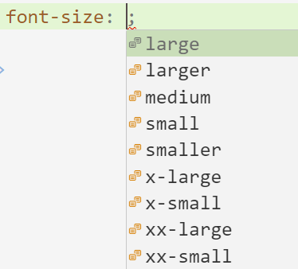
Typography/Fonts
font-size: 100px;
font-size: 2.5em;
font-size:300% ;

Slide 45
Typography/Fonts
line-height:
The line-height CSS property sets the height of a line box in horizontal writing modes. (gap between lines)
2px, larger, 200%, 1.6em;

Slide 46
fontEx.html
<!DOCTYPE html>
<html lang="en">
<head>
<meta charset="UTF-8">
<meta name="viewport" content="width=device-width, initial-scale=1.0">
<title>Document</title>
<style>
h1{
font-size: x-large;
font-family: 'Courier New', Courier, monospace;
font-style: italic;
color:brown;
background-color: aqua;
}

Slide 47
fontEx.html
h2{
font-size: 100px;
font-family: Arial;
font-style: oblique;
color: #f09;
background-color: #9a9af4;
}
h3{
font-size: 2.5em;
font-family: Verdana;
font-style: normal;
color:#8400ff;
background-color: #ffebcd;
}

Slide 48
p{
font-size:300% ;
font-family: 'Times New Roman', Times, serif;
font-style: italic;
color: rgb(5, 191, 5);
background-color: yellow;
}
</style>
</head>
<body>
<h1>This is h1 heading</h1>
<h2>This is h2 heading </h2>
<h3> This is h3 heading</h3>
<p> This is a paragraph </p>
</body>
</html>

Slide 49
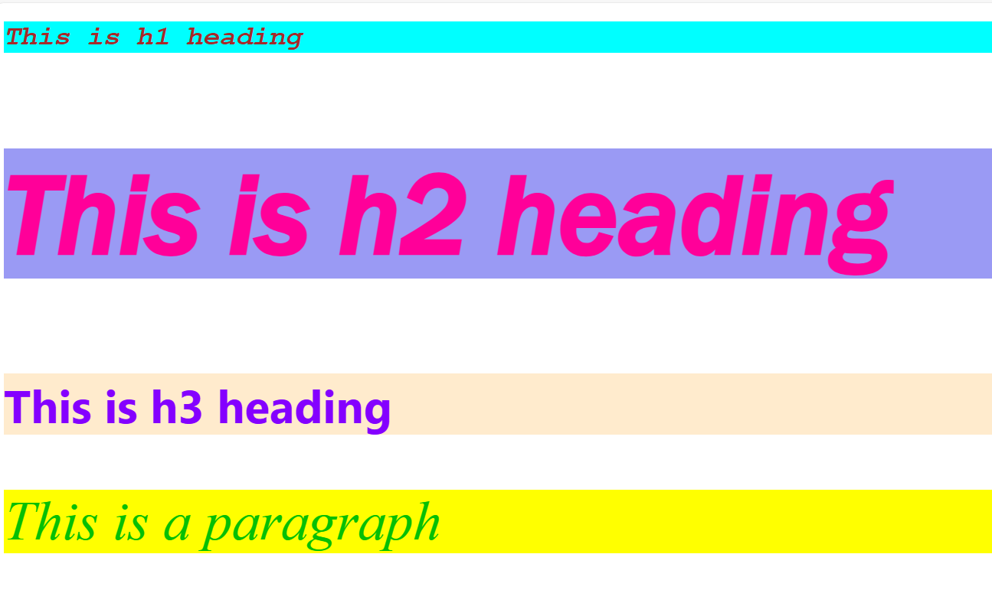
fontEx.html output

Slide 50
Text
Text Transform: Controls the capitalization of text.
text-transform: uppercase;
Values :none, capitalize, uppercase, lowercase
text-align: Aligns the text within an element.
text-align: center;
Values: Left, right, center, justify,start
Text Indent:
empty space (indentation) that is put before lines of text in a block.
text-indent: 50px
-2em; 30%; -ve values allowed

Slide 51
Text
Text Decoration:
text-decoration-line, text-decoration-color, text-decoration-style, and text-decoration-thickness
text-decoration-line : underline| overline|line-through;
text-decoration-style: solid | double | dotted | dashed | wavy
text-decoration-thickness: 1em/ 2px

Slide 52
Text
Letter Spacing: Adjusts the space between characters.
letter-spacing: normal | <length>(e.g., 3px, 0.2em, -1px).
Color: Sets the color of the text.
color: #333|rgb()|red;

Slide 53
Text
Text Transform: none, capitalize, uppercase, lowercase
Letter Spacing: normal | <length>(e.g., 3px, 0.2em, -1px).
Color
text-align: Left, right, center, justify,start
Text Indentation: -2em; 30%; 50px
Letter Spacing: normal | 2em,30px)
Text Decoration: (underline| overline|line-through) /(solid | double | dotted | dashed | wavy )
Eg: text-decoration: underline dotted red;

Slide 54
CSS Colors

Slide 55
CSS Color
CSS uses Hexadecimal or Numerical values to specify a color.
These are used to set the color of the background or foreground of an Html element. Colors in CSS can be specified in various formats.
Following table tells you all possible formats:
Format | Syntax | Example
Hex Code | #RRGGBB | p {color:#FF0000;}
Short Hex Code | #RGB | p {color:#6A7;}
RGB % | rgb(rrr%,ggg%,bbb%) | p{color:rgb(50%,50%,50%);}
RGB Absolute | rgb(rrr,ggg,bbb) | p {color:rgb(0,0,255);}
keyword | aqua, black, etc. | p {color:teal;}
RGB Alpha | rgba(red, green, blue, alpha) | p{color:rgba(255, 99, 71, 0);}
UI Web Development
Unit 2
Department of CSE

Slide 56
CSS Colors - Hex Codes
A hexadecimal is a 6 digit representation of a color.
First two digits(RR) represent a red value.
Next two digits(GG) represent a green value.
Last two digits(BB) represent a blue value.
A hexadecimal value can be taken from any graphics software like Adobe Photoshop, Jasc Paintshop Pro or even using Advanced Paint Brush.
Each hexadecimal code will be preceded by a hash sign #.
Examples to use Hexadecimal notation. #66AA77, #4488DD
Syntax
background: #FF0000;
UI Web Development
Unit 2
Department of CSE

Slide 57
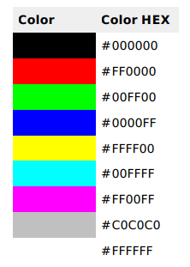
Following are the examples to use Hexadecimal notation
#ff0000 is displayed as red
#00ff00 is displayed as green
#0000ff is displayed as blue
#000000 is displayed as black
#ffffff is displayed as white
UI Web Development
Unit 2
Department of CSE

Slide 58
CSS Colors - Short Hex Codes
This is a shorter form of the six-digit notation. In this format, each digit is replicated to arrive at an equivalent six-digit value; For example: #6A7 becomes #66AA77.
A hexadecimal value can be taken from any graphics software like Adobe Photoshop, Jasc Paintshop Pro or even using Advanced Paint Brush.
Each hexadecimal code will be preceded by a pound or hash sign #.
Examples to use Hexadecimal notation. #6A7, #48D
Syntax
background: #FFF;
UI Web Development
Unit 2
Department of CSE

Slide 59
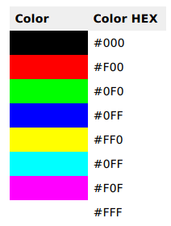
Following are the examples to use Short Hex notation.
UI Web Development
Unit 2
Department of CSE

Slide 60
CSS Colors - RGB Values
This color value is specified using the rgb( ) property. This property takes three values, one each for red, green, and blue. The value can be an integer between 0 and 255 or a percentage.
Note: All the browsers does not support rgb() property of color so it is recommended not to use it.
Syntax
background:rgb(142,54,76);
UI Web Development
Unit 2
Department of CSE

Slide 61
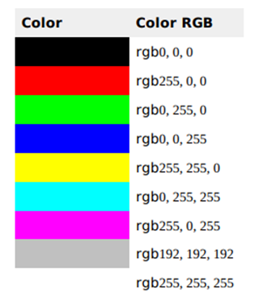
Following is the example to show few colors using RGB values.
rgb(255, 0, 0) is displayed as red
rgb(0, 255, 0) is displayed as green
rgb(0, 0, 255) is displayed as blue
rgb(0, 0, 0) is displayed as black
rgb(255,255,255) is displayed as white
UI Web Development
Unit 2
Department of CSE

Slide 62
RGBA Value
RGBA color values are an extension of RGB color values with an alpha channel - which specifies the opacity for a color.
An RGBA color value is specified with:
rgba(red, green, blue, alpha)
The alpha parameter is a number between
0.0 (fully transparent) and
1.0 (not transparent at all):

Slide 63
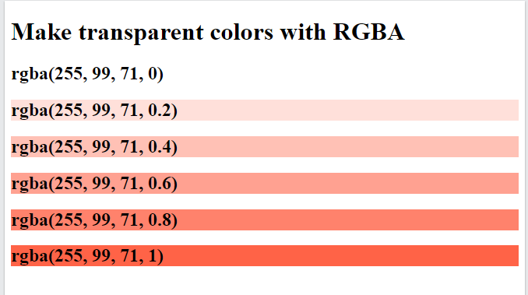
RGBA Value
<!DOCTYPE html>
<html>
<body>
<h1>Make transparent colors with RGBA</h1>
<h2 style="background-color:rgba(255, 99, 71, 0);"> rgba(255, 99, 71, 0)</h2>
<h2 style="background-color:rgba(255, 99, 71, 0.2);">rgba(255, 99, 71, 0.2)</h2>
<h2 style="background-color:rgba(255, 99, 71, 0.4);">rgba(255, 99, 71, 0.4)</h2>
<h2 style="background-color:rgba(255, 99, 71, 0.6);">rgba(255, 99, 71, 0.6)</h2>
<h2 style="background-color:rgba(255, 99, 71, 0.8);">rgba(255, 99, 71, 0.8)</h2>
<h2 style="background-color:rgba(255, 99, 71, 1);">rgba(255, 99, 71, 1)</h2>
</body>
</html>

Slide 64
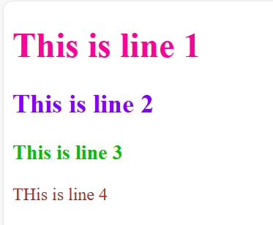
Colorex.html
<head>
<meta charset="UTF-8">
<meta name="viewport" content="width=device-width, initial-scale=1.0">
<title>Document</title>
<style>
p{
color:brown
}
h1{
color: #f09;
}
h2{
color:#8400ff }

Slide 65
Colorex.html
h3{
color: rgb(5, 191, 5);
}
</style>
</head>
<body>
<h1>This is line 1</h1>
<h2>This is line 2</h2>
<h3>This is line 3</h3>
<p>THis is line 4</p>
</body>

Slide 66
Border

Slide 67
CSS Border
The CSS border properties allow you to specify the style, size,and color of an Html element border.
Following CSS border properties are used for Html elements,
border-style: double, dotted, solid, dashed
border-width: thin, medium or thick
border-color:
border-radius: px or %
The border property is a shorthand property for:
border-width
border-style (required)
border-color
UI Web Development
Unit 2
Department of CSE

Slide 68
Border-Style
The border-style property specifies what kind of border to display.
Ex: double, dotted, solid, dashed etc
Border-Width
The border-width property is used to set the border width. It is set in pixels. You can also set the width of the border by using pre-defined values, thin, medium or thick
Border-Color
This properties are used for set the color of Html elements border.
There are three method to set the color of border.
Name, RGB, Hex
UI Web Development
Unit 2
Department of CSE

Slide 69
Border-Radius
border-radius are used for give the radius for border, using this you can make curved edges. Represented in px or %

Slide 70
Background

Slide 71
Background
CSS background property is used to define the background effects
on Html element.
There are CSS background properties that affects the Html elements.
background-color
background-image
background-repeat: Repeat| space| round
background-attachment: fixed |scroll
background-position: top/bottom/center/left/right
The background shorthand CSS property sets all background style properties at once, such as color, image, origin and size, or repeat method.
UI Web Development
Unit 2
Department of CSE

Slide 72
CSS background-color
The background-color property is used to specify the background color of the Html element.
Example
<style>
h3{
background-color :yellow;
}
p{
background-color :cyan;
}
UI Web Development
Unit 2
Department of CSE

Slide 73
background-image
The background-image property is used to specify the image in background of the Html element.
Example
<style>
p{
background-image: url(“sky.jpg");
}
</style>
UI Web Development
Unit 2
Department of CSE

Slide 74
CSS background-repeat
By default, the background-image property repeats the background
image horizontally and vertically.
Some images are repeated only horizontally or vertically. If you do not want to repeat background image then set no-repeat.
Values: Repeat, space, round
Example
<style>
p{
background-image: url(“sky.jpg");
background-repeat: space;
}
</style>
UI Web Development
Unit 2
Department of CSE

Slide 75
CSS background-position
background-position is use only in case of when you use image in background of any Html elements. It is used to define the initial position of the background image. By default, the background image is placed on the top-left of the webpage. You can set position of background, all background image position are given below;
top
bottom
center
left
right
UI Web Development
Unit 2
Department of CSE

Slide 76
background-attachment
background-attachment CSS property determines whether a background image scrolls with the rest of the page or remains fixed
scroll: The background image scrolls with the page. This is the default value.
fixed: The background image stays fixed relative to the viewport, even when the page is scrolled.
body {
background-image: url("example.jpg");
background-repeat: no-repeat;
background-attachment: fixed;
}

Slide 77
backgroundEx.html
<!DOCTYPE html>
<html lang="en">
<head>
<meta charset="UTF-8">
<meta name="viewport" content="width=device-width, initial-scale=1.0">
<title>Background example</title>
<style>
h1 {
background: green;
text-align: center;
}

Slide 78
p {
text-align: center;
text-wrap : wrap;
color: black;
background-image: url(“sky.jpg");
background-repeat: space;
background-position: bottom;
padding: 100px;
}
</style>
</head>
<body>
<h1>CSS Background example</h1>
<p> This is a paragraph element.This is a paragraph element.This is a paragraph element.This is a paragraph element.
This is a paragraph element.This is a paragraph element.This is a paragraph element. </p> </body> </html>

Slide 79
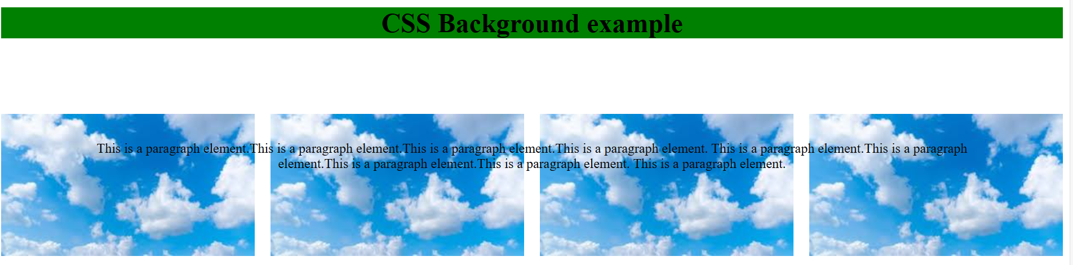

Slide 80
Gradient and shadows.

Slide 81
CSS gradients
CSS gradients let you display smooth transitions between two or more specified colors.
<gradient> data type, which is a special kind of <image>.
CSS defines three types of gradients:
Linear Gradients (goes down/up/left/right/diagonally)
Radial Gradients (defined by their center)
Conic Gradients (rotated around a center point)
UI Web Development
Unit 2
Department of CSE

Slide 82
CSS Linear Gradients
transition between two or more colors along a straight line..
Color stops are the colors you want to render smooth transitions among.
You can also set a starting point and a direction (or an angle) along with the gradient effect.
A linear gradient is defined by an axis—the gradient line—and two or more color-stop points.
<style>
#grad1 {
height: 200px;
background: linear-gradient( red, blue);}
</style>
<div id="grad1"></div>
UI Web Development
Unit 2
Department of CSE

Slide 83
CSS Radial Gradients
A radial gradient is defined by its center.
To create a radial gradient you must also define at least two color stops.
transition between two or more colors that radiate from an origin. Its shape may be a circle or an ellipse.
<style>
#grad1 {
height: 150px;
width: 200px;
background: radial-gradient(red, yellow, green, blue);
}
</style>
<div id="grad1"></div>
UI Web Development
Unit 2
Department of CSE

Slide 84
CSS Conic Gradients
A conic gradient is a gradient with color transitions rotated around a center point.
To create a conic gradient you must define at least two colors.
<style>
#grad1 {
height: 200px;
width: 200px;
background-color: red; /* For browsers that do not support gradients */
background-image: conic-gradient(red, yellow, green);
}
</style>
<div id="grad1"></div>
UI Web Development
Unit 2
Department of CSE

Slide 85
CSS Shadows
CSS Shadows are a visual effect that consists of a drawing that resembles an object's shadow; these shadows provide a 3-dimensional appearance to the object. In CSS, mainly the text-shadow and the box-shadow property is used to add shadows to texts and elements.
CSS text-shadow property
The Text-shadow property is used to decorate the text of the viewport by adding shadows. It provides an additional attraction to texts on websites.
Example
<style>
h1 {
text-shadow: 2px 2px 5px grey;
}
</style>
offset :shadow's distance from the text.
blur-radius :shadow becomes wider and lighter
offset-x | offset-y | blur-radius | color
text-shadow: 2px 2px 5px grey;
UI Web Development
Unit 2
Department of CSE

Slide 86
CSS box-shadow property
The box-shadow property is used to decorate HTML elements of the viewport.
Every single HTML element is treated as a box by CSS.
These boxes can be given multiple shadow effects with CSS's box-shadow property.
<style>
div {
width: 300px;
height: 100px;
padding: 15px;
background-color: coral;
box-shadow: 2px 2px 2px 1px rgb(32,210,109);
}
</style>
UI Web Development
Unit 2
Department of CSE

Slide 87
box-shadow :
<offset-x> | <offset-y> | <blur-radius> | <spread-radius> | <color>
box-shadow: 2px 2px 2px 1px rgb(32,210,109);
<spread-radius>: Positive values will cause the shadow to expand and grow bigger, negative values will cause the shadow to shrink.

Slide 88
Thank You
UI Web Development
Unit 2
Department of CSE

